Slide 1


National School of Engineers of Sfax
Department of Electrical Engineering
Creating Smart IoT Systems:
From Local Web Servers to Cloud-Connected Solutions
Supervisor : Mr. Nouri Ahmed SAIID
Examiner : Ms. Sinda ALOUI
Students:
Ahmed AYADI
Ahmed ABDELWAHEB
Karim KAMMOUN
University year : 2023/2024

Slide 2
Presentation Plan
Building a Web Server with ESP32 for IoT Projects
Overcoming Local Network Limitations with Firebase
Building a Sign-Up and Login Webpage with Data
Integration from Firebase
Conclusion and perspectives
1

Slide 3
Presentation Plan
Building a Web Server with ESP32 for IoT Projects
Overcoming Local Network Limitations with Firebase
Building a Sign-Up and Login Webpage with Data
Integration from Firebase
Conclusion and perspectives
2

Slide 4
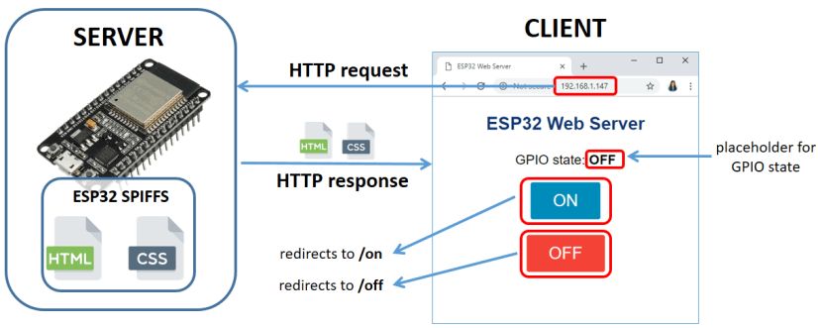

Building a Web Server with ESP32 for IoT Projects
Servers
HTTP (Port)
IP @
TCP/IP
Router
Mac @ (Proadcast)
3

Slide 5
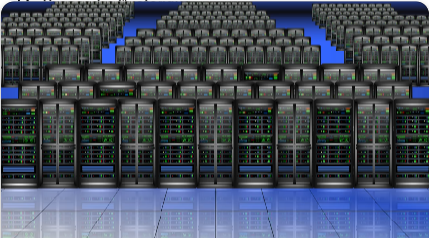
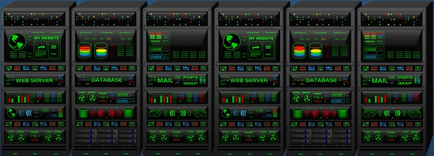
Building a Web Server with ESP32 for IoT Projects
General process the aim of this chap is to create a web server using esp32 but what is exactly a server ?
Most think of it as big robust machine but this is not the accurate and exact definition of a server.
It’s true that servers can be strong big machines but even a computer or an electronic board can play the role of a server could you believe it .
4

Slide 6
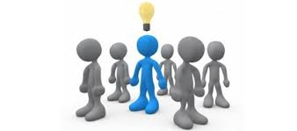
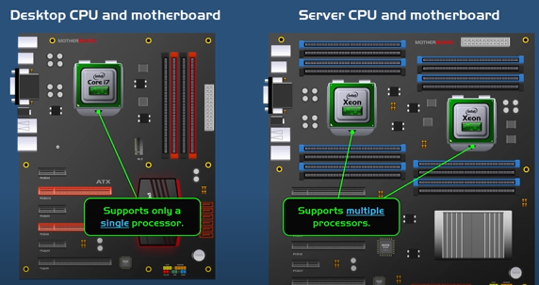
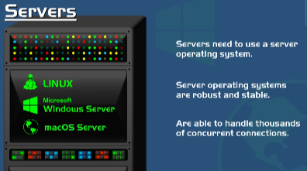
Introduction
So what is the exact defition of a sever ? to know that le’s discover first the components needed for a server to be built
In fact to build a server we basically need:
Cpu
Ram
Strorage (hdds or ssd)
Motherboard
Power supply unit
Operating system
Network interface
And a cooling system
5

Slide 7

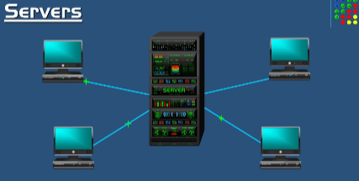
Server
A user send a request to a server for a specific service and a server will serve him that service he asked for as a response and this is called a request/response cycle .This is the exact definition of a server many machine or device which can perform this cycle it’s called aserver (welcome to the family of servers)
For big companies like google and amazon we need a qualified and very robust hardware to support the millions of services per second and can function permantly 24/24 but this is not always the case
Even liitle tiny electronic board or pc can play the role of a server
We will see that later but let’s first take the example of the robust basic servers that are meant to play only the role of a server
6

Slide 8
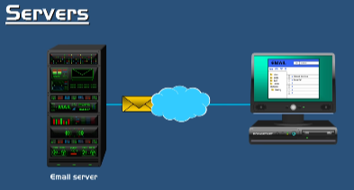
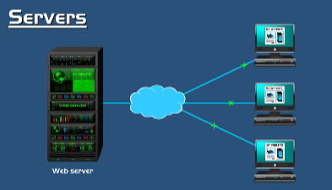
Server
Email server
User send request to a server then server receive it and fetch for the appropriate query requested by the user and send it to him as a response
Webservers
7
7

Slide 9
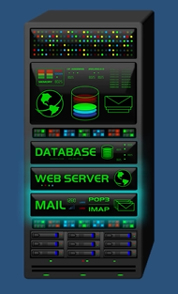
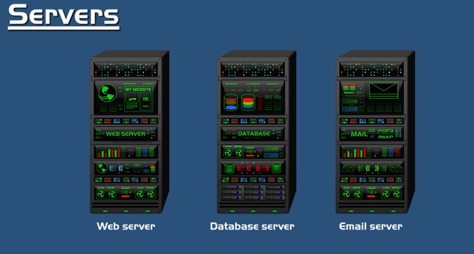
Server
Web database email servers each on a separated server
Combined
8

Slide 10
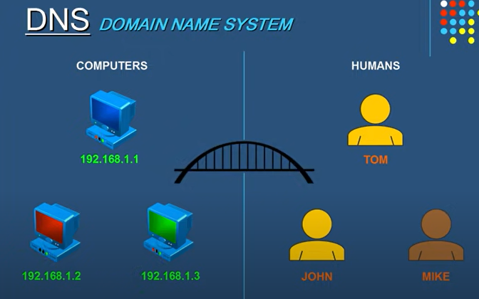
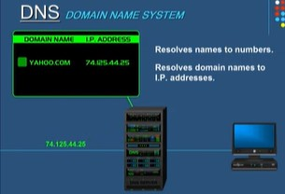
Etude et conception
DNS Server
Explain in brief what is an ip address
DNS server
It’s give us the location of anydevice on a network which mean in order to have communication with other devices on a network a device need to have an ip address otherwise no communication will take place
9

Slide 11
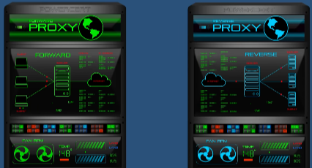
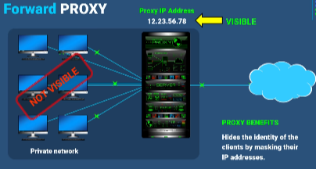
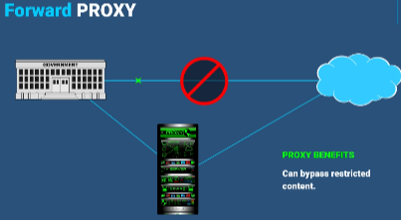
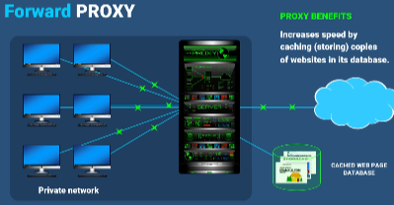
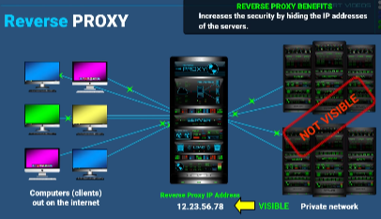
Forward Proxy and reverse proxy
Forward Proxy and reverse proxy
10

Slide 12
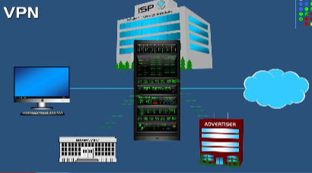
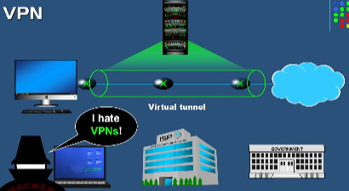
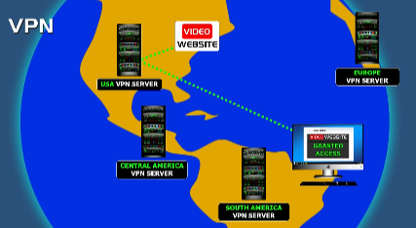
VPN Servers
VPN servers
Servers can be even computers or electronic boards but they are
meant for small tasks
11

Slide 13
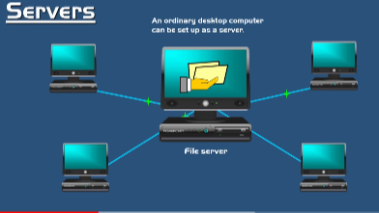
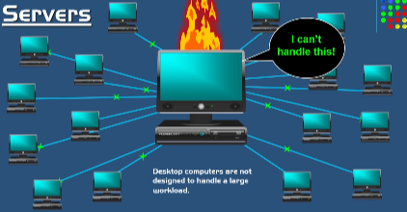
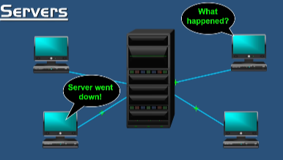
Server
Otherwise this
12

Slide 14
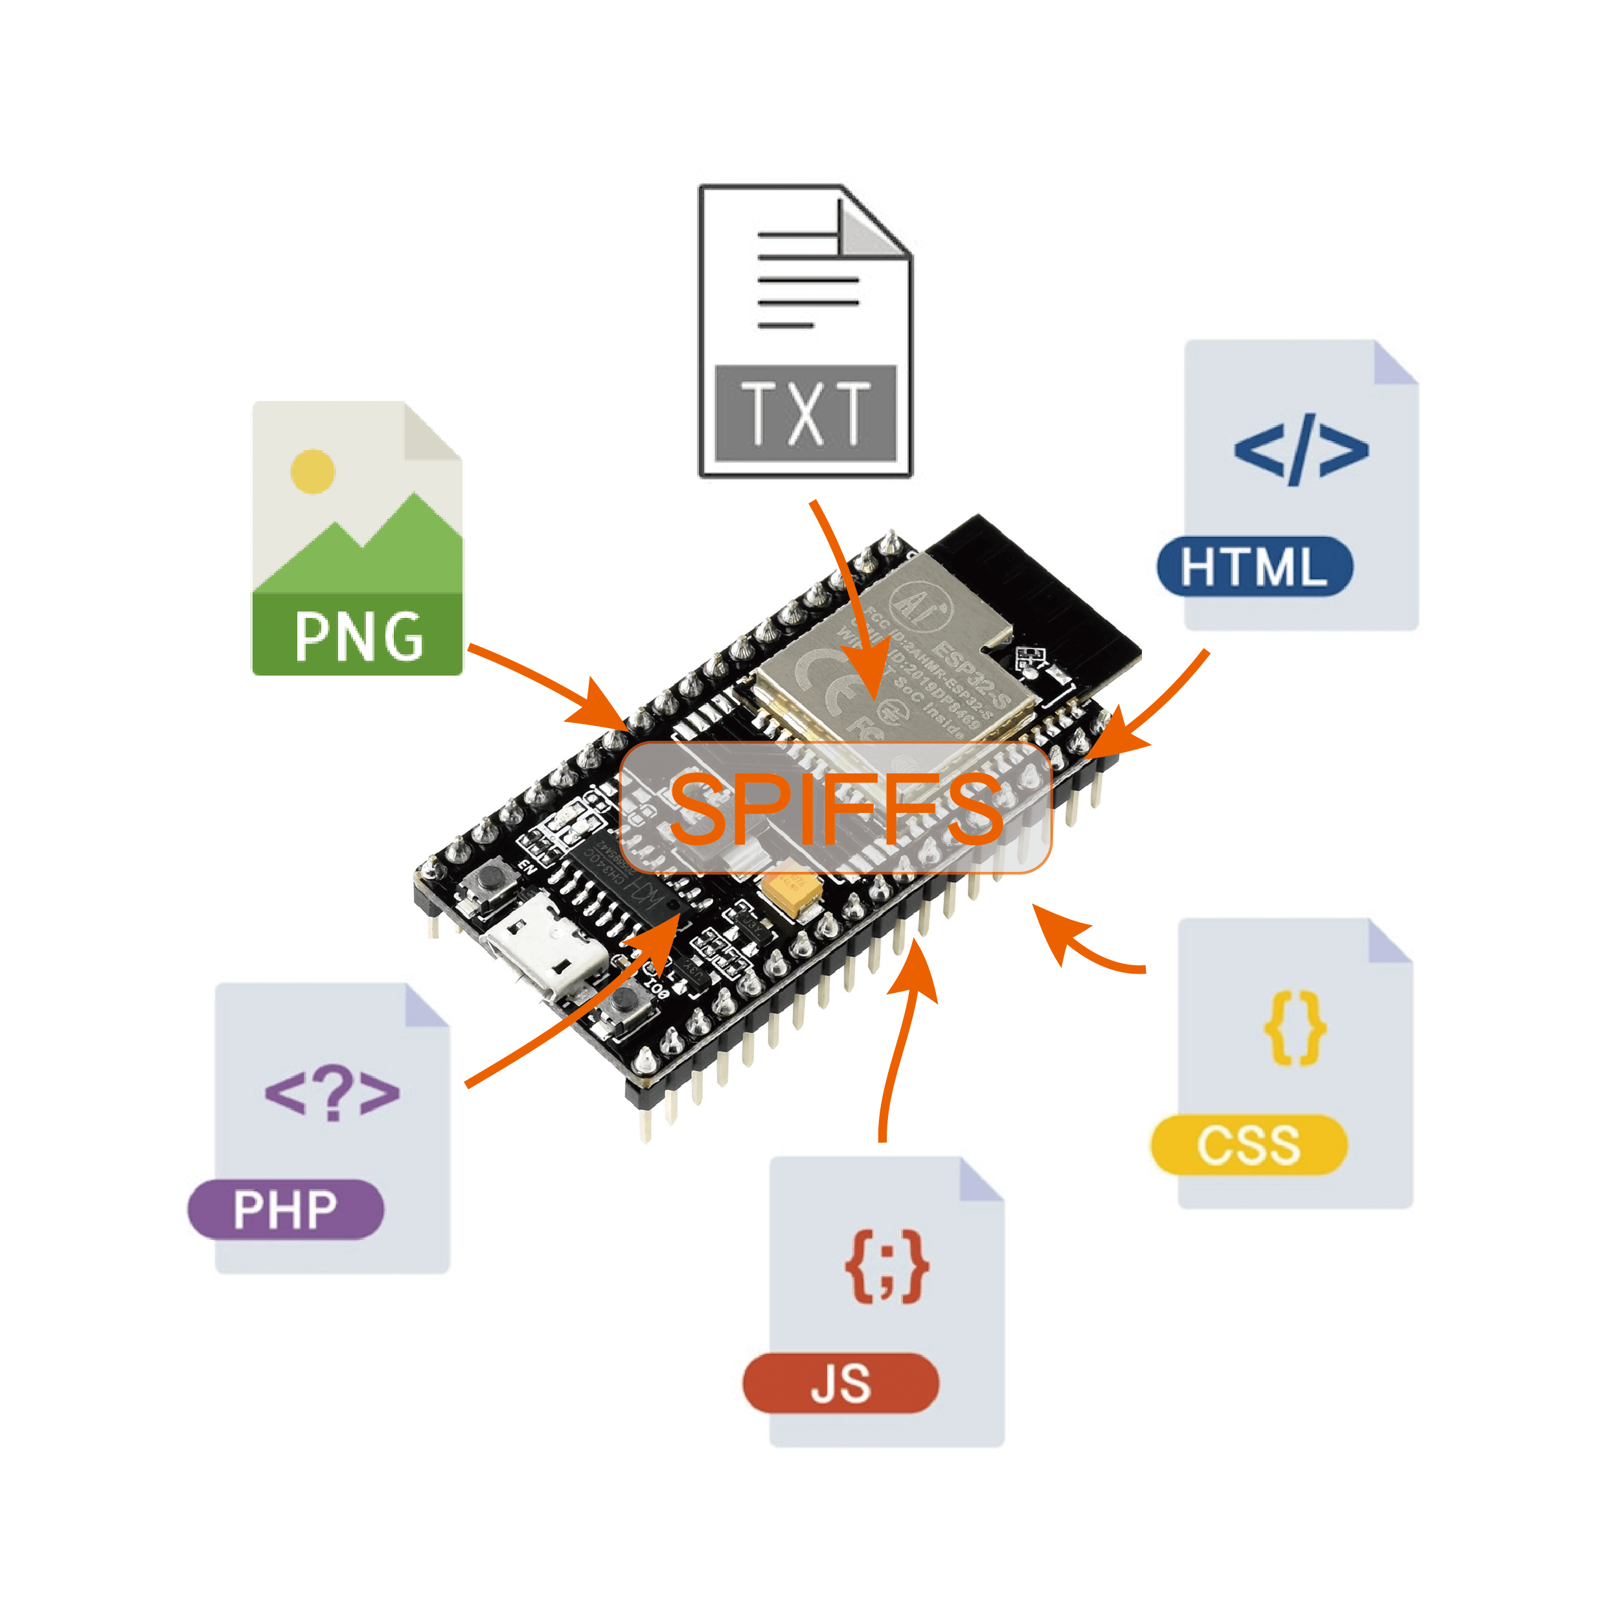
ESP32
13

Slide 15
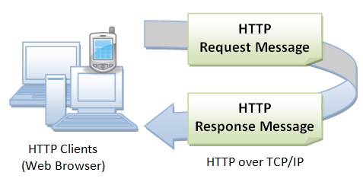
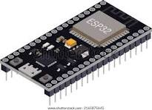
Connectivity
14

Slide 16
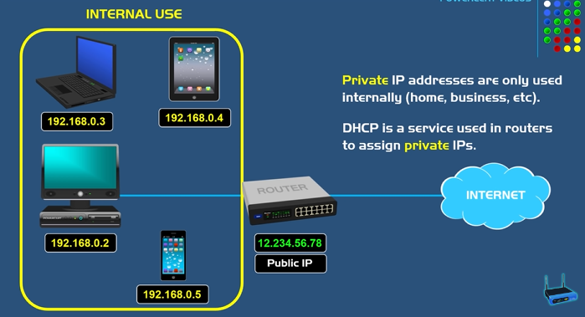
Private IP adresses
15

Slide 17
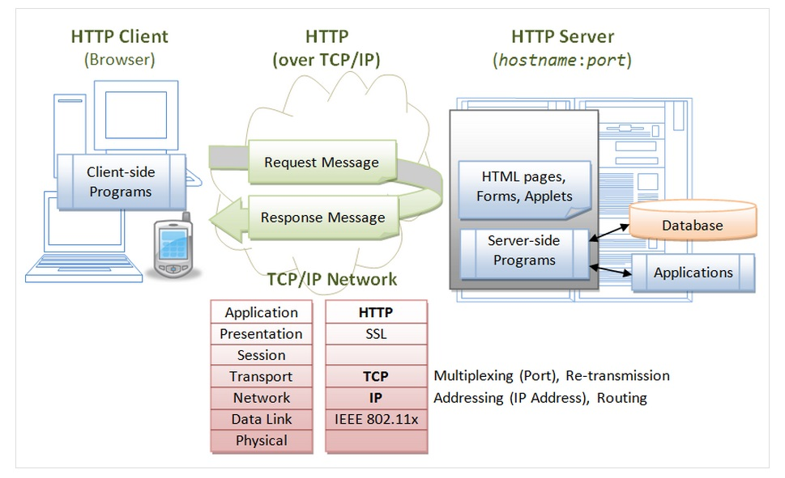
HTTP
16

Slide 18
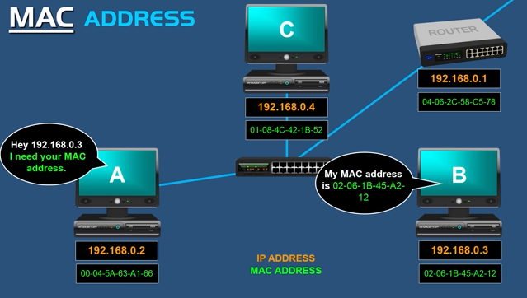
MAC ARRRESS
17

Slide 19
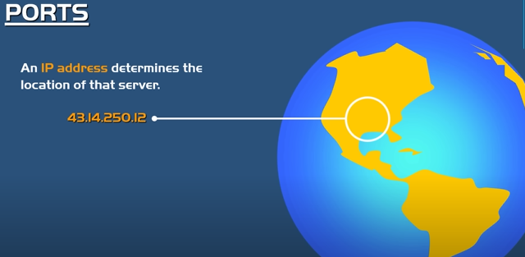
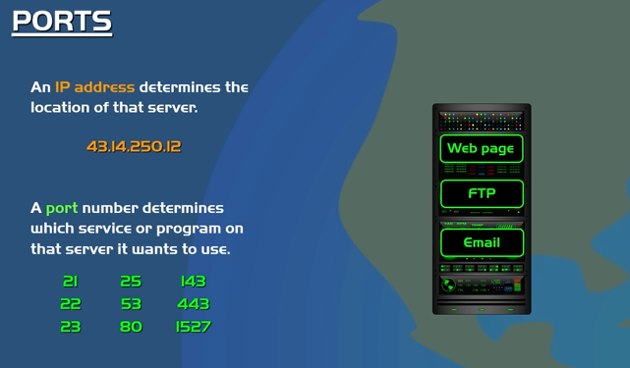
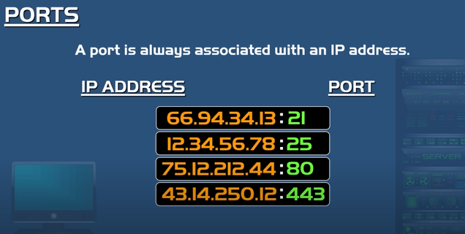
IP ARRRESS
18

Slide 20
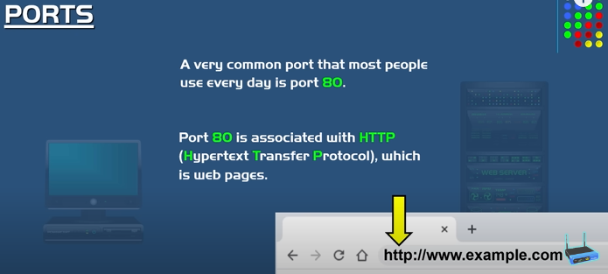
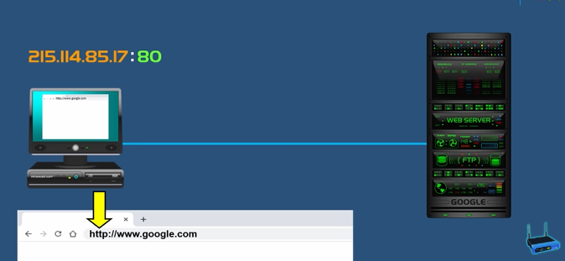
Ports
19

Slide 21
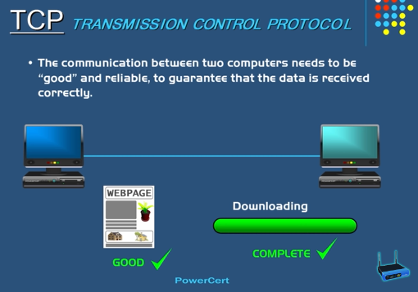
TCP
20

Slide 22
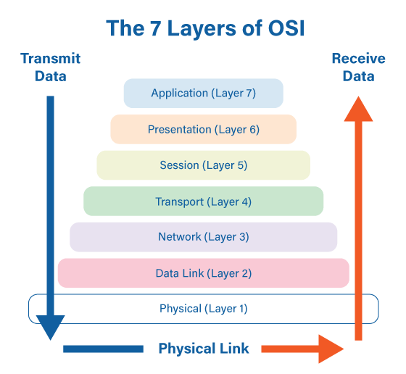
ESP32 Connectivity
21

Slide 23
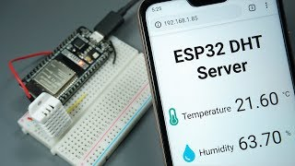
Mini-project1: Reading temperature data
Our first mini project is about reading temperature data using dht11 and display it on an interactive webpage through the esp32 webserver.
To do that we started by connecting dht11 to the esp32 using wires.
After that we write an arduino ide code to capture temperature data from the sensor.
Then using html and css we implemented a script to create the layout and the styling of our webpage.
22

Slide 24
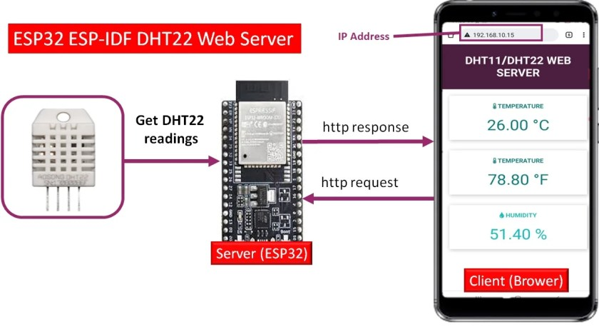
Mini-project1: Reading temperature data
After connecting the esp32 to the local area network we upload the code and then by making an http request using the private IP address of esp32 we obtain finally our web interface in which our temperature data is updated every moment.
23

Slide 25
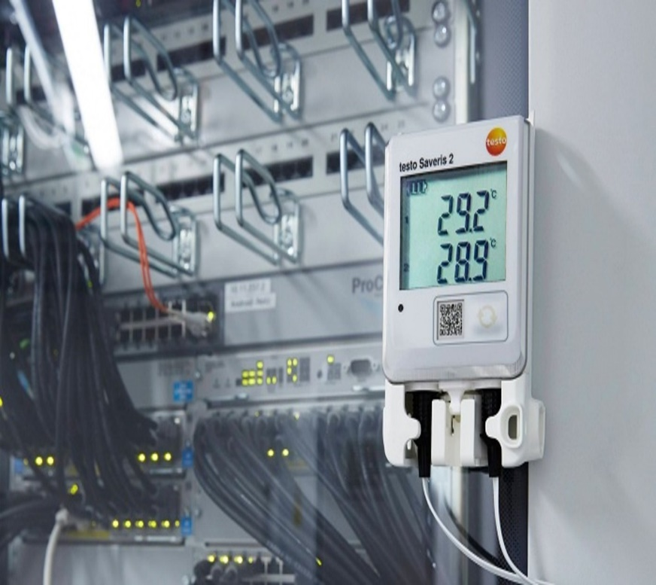
Mini-project1: Reading temperature data
This Iot project can be very important in sevral applications.
We can use it to track temperature levels and automatically activate cooloing systems when necessary.
Even in big companies that have many servers and machines that are functioning 24/24h those kind of applications are needed to detect the level of temperature and provide the best conditions for the hardware side to function approparly and track it through a web interface .
24

Slide 26
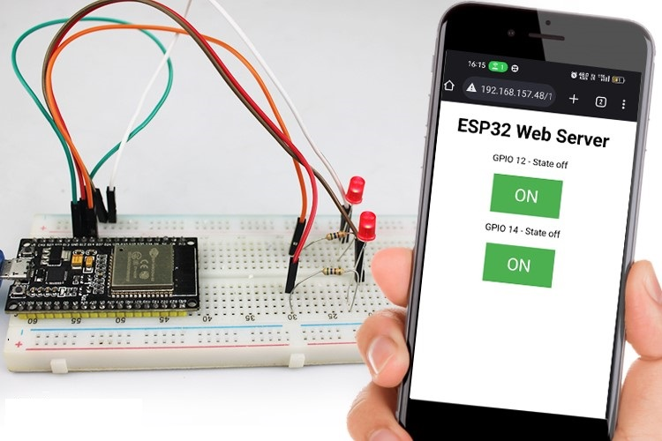
Mini-Project 2: Controlling LEDs with a Web Page
The second mini-project focuses on controlling two LEDs through a web interface.
25

Slide 27
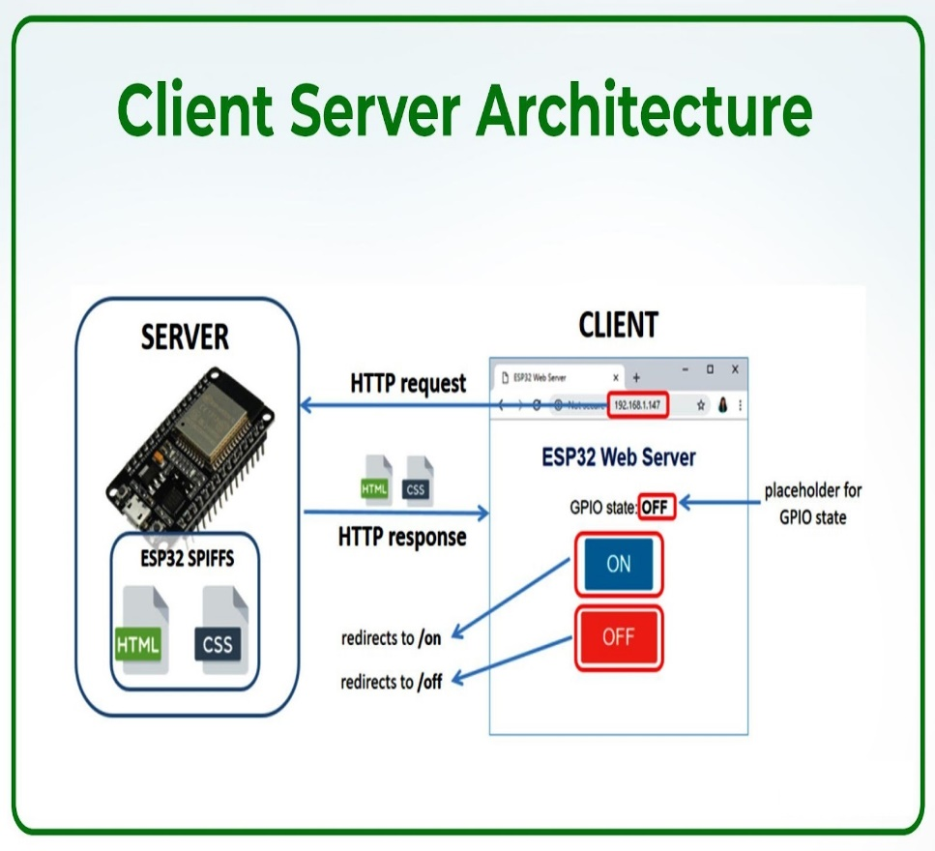
Mini-Project 2: Controlling LEDs with a Web Page
Setting Up the LEDs
Creating the Web Interface
Accessing the Web Page
26

Slide 28
Mini-Project 3: Controlling an RGB LED with a Web Interface
Mini-project 3 involves controlling an RGB LED's color through a web interface served by an ESP32, using manual intensity input and a color wheel.
A. Web interface with Manual RGB Color Selection:
Using HTML and CSS we create a web interface that includes inputs fields for each color.
Editing an Arduino code that adjusts the color intensity based on user input
B. Web interface with color wheel:
Integration of the color wheel into the web page using HTML, CSS, and potentially JavaScript for interactive functionality.
Updating the Arduino code to handle input from the color wheel, converting the selected color into RGB values.
controlling hardware components with a web interface can be integrated into broader smart home systems
27

Slide 29
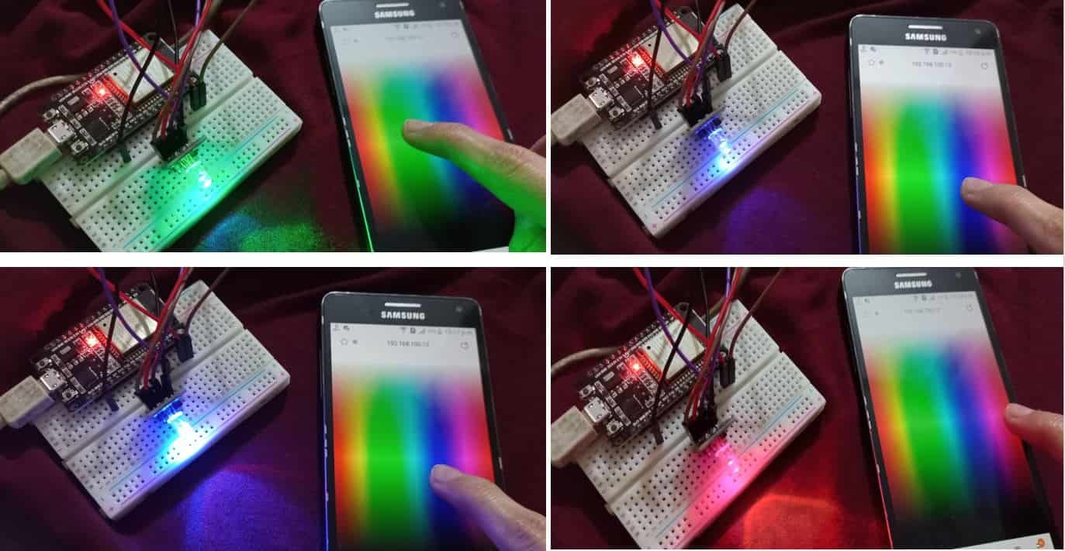
Mini-Project 3: Controlling an RGB LED with a Web Interface
We provide a more user friendly approach to color selection.
28

Slide 30
Limitations of the ESP32 Web Server:
Limitations of the ESP32 Web Server:
Creating a web server with Esp32, interacting with sensors and controlling devices through web interfaces is limited to a local network .
We suggest to use Firebase as a cloud service to enable remote access and control from anyweher.
29

Slide 31
Presentation Plan
Building a Web Server with ESP32 for IoT Projects
Overcoming Local Network Limitations with Firebase
Building a Sign-Up and Login Webpage with Data
Integration from Firebase
Conclusion and perspectives
30

Slide 32
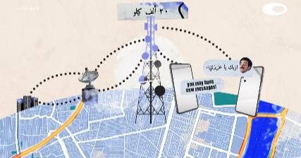
Cloud computing
31

Slide 33
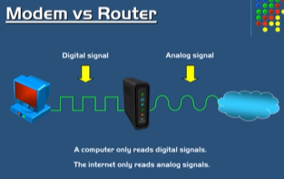
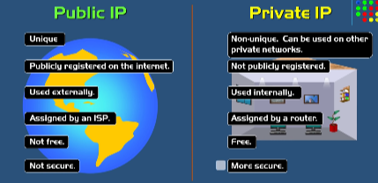
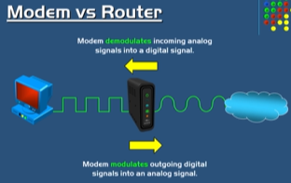
Modem VS Router
32

Slide 34
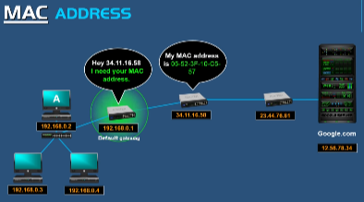
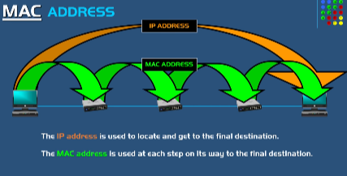
MAC ADRESS
33

Slide 35
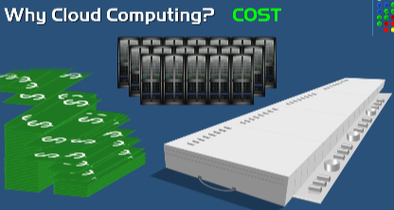

CLOUD
34

Slide 36


CLOUD
35

Slide 37

Cloud Server
36

Slide 38

Cloud Server
37

Slide 39

ESP32 to Firebase
The ESP32 connects to Firebase to send temperature data.
In the Arduino IDE, a code is written to connect the ESP32 to Firebase, allowing it to send temperature data securely.
38

Slide 40


ESP32 to Firebase
- Temperature data is read from the ESP32 and sent to Firebase in real time.
- The real-time database allows data to be accessed from any location, providing flexibility and scalability.
- To access the temperature data, users log in to Firebase and retrieve the data from the database.
- This approach allows access to the data from anywhere in the world, demonstrating the power of cloud computing.
39

Slide 41

Mini-Project 2: Controlling an LED with Firebase
This project demonstrates how to use Firebase to control a LED through a cloud. Users can set the state of an LED to "on" or "off" by interacting with Firebase, demonstrating the ability to control devices remotely.
40

Slide 42

Mini-Project 2: Controlling an LED with Firebase
The ESP32 connects to Firebase to send and retrieve data securely.
Users can set the state of the LED to "on" or "off" by updating the Firebase database.
An Arduino code is written enabling to Esp 32 to check the state of the LED in the Firebase database and activate or deactivate it accordingly.
41

Slide 43




Building User Interfaces with MIT App Inventor
To create a user-friendly interface, we use MIT App Inventor to develop a mobile application that connects to Firebase. This app allows users to retrieve temperature data and control the LED from their phones.
42

Slide 44
MIT App Inventor
Using MIT App Inventor, we build a mobile app that connects to Firebase using the URL, API address, and secret link of the database. The users can retrieve temperature data and control the LED.
Only authenticated users can access the Firebase data, ensuring security and privacy
The app provides a user-friendly interface for interacting with the IoT project, making it easy to retrieve data and control devices.
This integration demonstrates the potential of cloud computing, embedded systems, and mobile development, highlighting the flexibility and power of cloud-based IoT projects.
43

Slide 45
Presentation Plan
Building a Web Server with ESP32 for IoT Projects
Overcoming Local Network Limitations with Firebase
Building a Sign-Up and Login Webpage with Data
Integration from Firebase
Conclusion and perspectives
44

Slide 46


ESP32 to Firebase
45

Slide 47

ESP32 to Firebase
46

Slide 48

ESP32 to Firebase
47

Slide 49
Presentation Plan
Building a Web Server with ESP32 for IoT Projects
Overcoming Local Network Limitations with Firebase
Building a Sign-Up and Login Webpage with Data
Integration from Firebase
Conclusion and perspectives
48

Slide 50
Conclusion and perspectives
By the end of the project, we had successfully integrated various fields, including embedded systems, web development, cloud computing, networking, databases, and security. The skills and knowledge gained throughout this project offer a strong foundation for future IoT endeavors, paving the way for further innovation and complex integrations.
49

Slide 51
THANKS
THANK YOU VERY MUCH
50

